Slide 1
PROGRAMMING IN C
Hareesh P S
Assistant Professor
Dept. of Physics
NSS College, Pandalam

Slide 2
CONTENTS
What is a Programming Language
Different levels of Programming languages
Machine Language
Assembly Language
High level Languages
Introduction to C Programming
C Keywords and Identifiers
Character set
C Tokens

Slide 3
What is a programming language?
A natural language is designed communicate between humans
A programming language is designed to communicate between human and computers

Slide 4
Levels of programming Languages
Machine languages
Assembly language
High level langugage

Slide 5
Machine language
Machine language is the language written as strings of binary 1’s and 0’s.
It is the only language which a computer understands without using a translation program.
A machine language instruction has two parts, the first part is the operation code which tells the computer what function to perform and the second part is the operand which tells the computer where to find or store the data which is to be manipulated.
A programmer needs to write numeric codes for the instruction and storage location of data.
Example
0011 0000 0000 0000 ; load at x3000 X3000 0010 001 0 0000 0110 ; LD R1, x006 x3001 0110 010 001 000000 ; LDR R2, R1, #0 x3002 0000 010 0 0000 0101 ; BRz x005

Slide 6
Assembly language
It is a low level programming language that allows a user to write a program using alphanumeric mnemonic codes, instead of numeric codes for a set of instructions.
It requires a translator known as assembler to convert assembly language into machine language so that it can be understood by the computer.
It is easier to remember and write than machine language.

Slide 8
High level language
It is a machine independent language.
It enables a user to write programs in a language which resembles English words and familer mathematical symbols.
COBOL was the first high level language developed for business.
A Compiler is a translator program which translates a high level programming language into equivalent machine language programs.

Slide 9
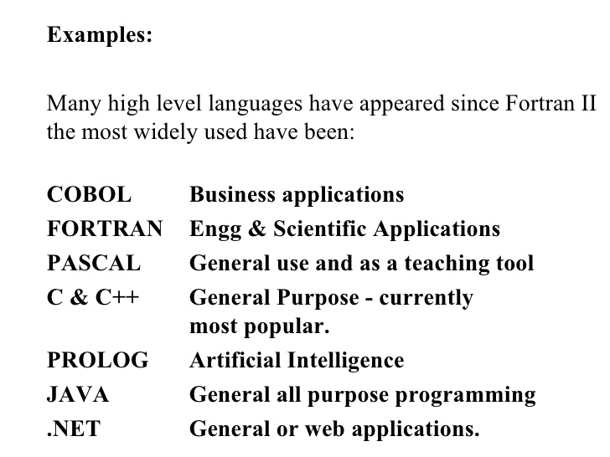

Slide 10
What is C ?
A widely used programming language developed in the early 1970s at Bell Laboratories
C is a by product of the UNIX operating system which was developed at Bell Laboratories by Ken Thompson, Dennis Ritchie and others.

Slide 11
UNIX was written in assembly language which is painful to debug and hard to enhance. Thomson decided that a higher level language was needed for the further development of UNIX. So he designed a small language named B. Ritchie soon joined the UNIX project and began programming in B
Ritchie began to develop an extended version of B. He called his language NB (“New B”) at first and then as it began to diverge more from B, he changed the name to C

Slide 12
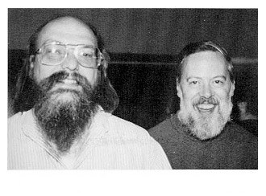
Ken Thompson & Dennis Ritchie

Slide 13
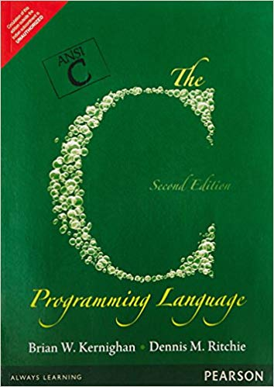
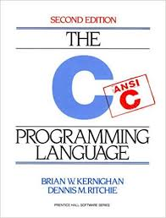
C continued to evolve during the 1970s especially between 1977 and 1979. It was during this period that the first book on C appeared “The C Programming Language” written by Ritchie and Brian Kernighan and published in 1978

Slide 14
ANSI C
The development of a US standard for C began in 1983 under the auspicious of the American National Standards Institute (ANSI).

Slide 15
Sample program 1: Printing a message
main()
{
/*...........printing begins.........*/
Printf(“I see, I remember”);
/*......printing ends*/
}

Slide 16
C keywords & Identifiers
Table of Contents
Character set
Keywords
Identifiers
Rules for naming Identifiers (variables, functions etc.)

Slide 17
Character set
Character set is a set of alphabets, letters and some special characters that are valid in C language
Alphabets - C accepts both lowercase and uppercase alphabets as variables and functions.
Uppercase: A B C ................................... X Y Z
Lowercase: a b c ...................................... x y z
Digits 0 1 2 3 4 5 6 7 8 9

Slide 18
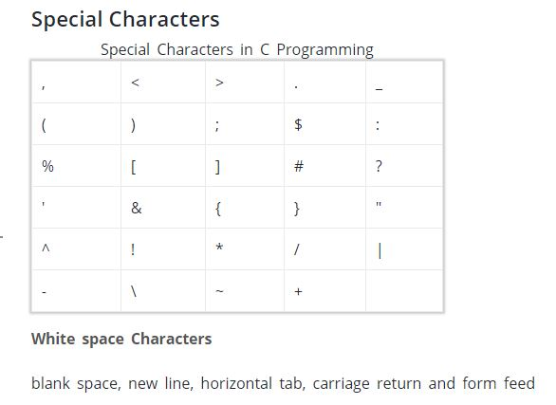

Slide 19
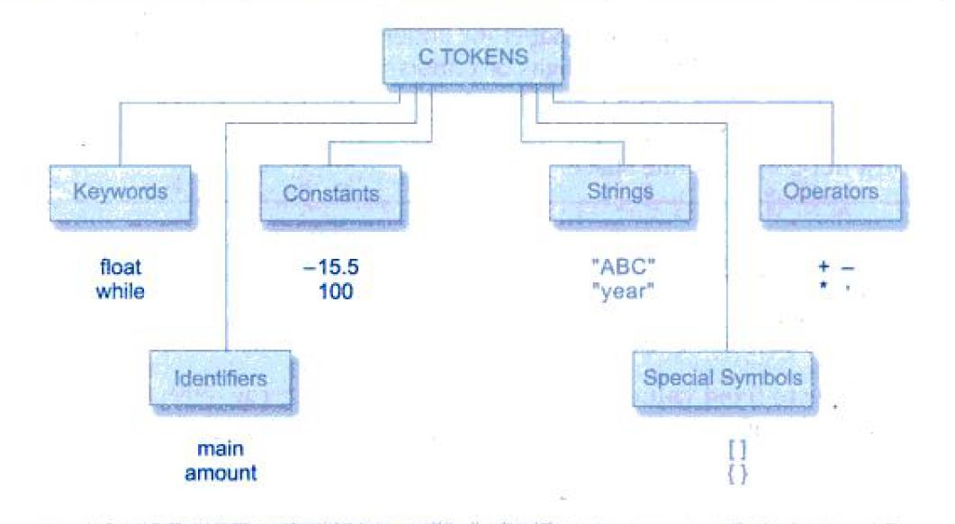
C Tokens
In a passage of text individual words and punctuation marks are called tokens.Similarly in a C program the smallest individual units are known as C tokens. C has 6 types of tokens

Slide 20
Keywords
Keywords are predefined, reserved words used in programming that have special meanings to the compiler. Keywords are part of the syntax and they cannot be used as an identifier
For example: int money;
Here, int is a keyword that indicates 'money' is a variable of type integer.
As C is a case sensitive language, all keywords must be written in lowercase.

Slide 21
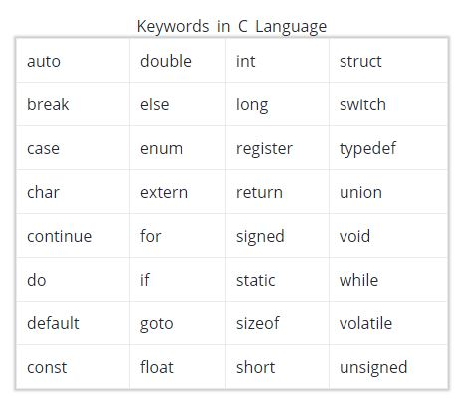

Slide 22
Identifiers
Identifier refers to name given to entities such as variables, functions, structures etc
Identifier must be unique. They are created to give unique name to an entity to identify it during the execution of the program
For example: int money;
double account balance;
Here, money and account balance are identifiers.
Identifier names must be different from keywords. You cannot use int as an identifier because int is a keyword.

Slide 23
Rules for naming identifiers
A valid identifier can have letters (both uppercase and lowercase letters), digits and underscores.
The first letter of an identifier should be either a letter or an underscore.
There is no rule on how long an identifier can be. However, you may run into problems in some compilers if identifier is longer than 31 characters.

Slide 24
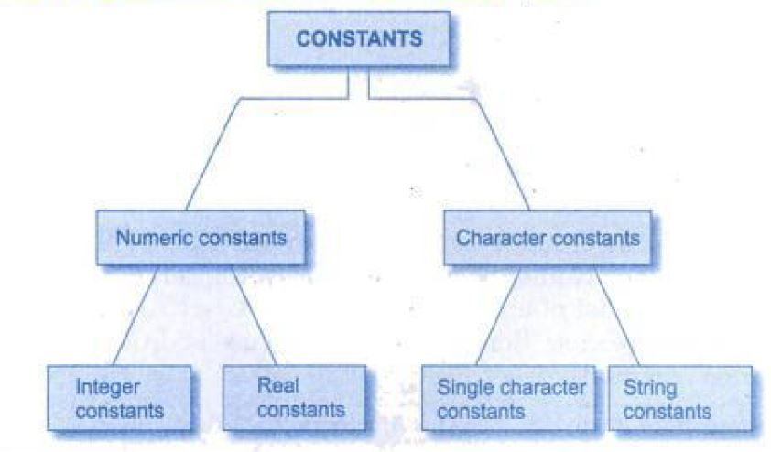
Constants
Constants in C refers to fixed values that do not change during the execution of a program

Slide 25
Numeric Constants in C
Integer Constants
An integer is a numeric constant without any fractional or exponential part. There are three types of integer constants in C programming:
Decimal constant (base 10)
Octal constant(base 8)
Hexadecimal constant(base 16)
For example:
Decimal constants: 0, -9, 22 etc
Octal constants: 021, 077, 033 etc
Hexadecimal constants: 0x7f, 0x2a, 0x521 etc
In C programming, octal starts with a 0, and hexadecimal starts with a 0x.

Slide 26
Real constants
Integer numbers are inadequate to represent quantities that vary continuously such as distances, temperatures,prices and so on. These quantities are represented by numbers containing fractional parts like 17.548. Such numbers are real (or floating point) constants.
Eg:0.0083 -0.75 435.36 +247.0
A real number may also be expressed in exponential (or scientific) notation.
Eg: 215.65 may be written as 2.1565e2 in exponential notation.e2 means multiply by 10^{2.}
The general form is
mantissa e exponent
mantissa is either a real number or an integer, the exponent is an integer number with an optional plus or minus sign
Eg: 0.65e4 12e-2 1.5e+3 3.18E3 -1.2E-1
Embeded white space is not allowed.
Exponential notation is useful for representing numbers that are either very large or very small in magnitude.

Slide 27
Examples of numeric constants

Slide 28
Character Constants
Single character constants
It contains a single character enclosed within a pair of single quote marks.
Eg: ‘5’ ‘X’ ‘;’ ‘’
the character constant ‘5’ is not the same as the number 5
Character constants have integer values known as ASCII VALUES.
Eg: the statement printf(“%d”, ’a’); Would print the number 97

Slide 29
String constants
It is a sequence of characters enclosed in double quotes.
the characters may be letters, numbers special characters and blank space
Eg: “Hello” “1983” “MELCOW” “ ” “5+3”
A character constant is not equivalent to the single character string constant
(ie ‘x’ not equal to “x”)
A single character string constant does not have an equivalent integer value while a character constant has an integer value

Slide 30
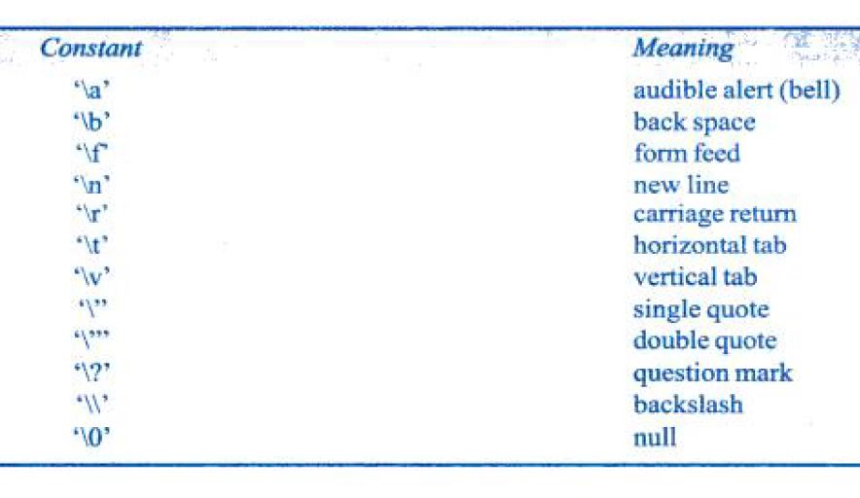
Backslash character constants
C supports some special backlash character constants that are used in output functions.\n stands for newline character.

Slide 31
C Programming Variables
A variable is a data name that may be used to store a data value. Unlike constants that reamin unchanged during the execution of a program a variable may take different values at different times during execution.
Variable names may consists of letters, digits and undescores subject to the following conditions
They must begin with a letter

Slide 32
Rules for naming a variable
A variable name can have letters (both uppercase and lowercase letters), digits and underscore only.
The first letter of a variable should be either a letter or an underscore.
There is no rule on how long a variable name (identifier) can be.
Note: You should always try to give meaningful names to variables. For example: firstName is a better variable name than fn.

Slide 33
Variables cont..
ANSI standard recognize a length of 31 characters. However length should be normally more than eight characters, since only the first eight characters are treated as significant by many compilers
Uppercase and lowercase are significant
It should not be a keyword
White space is not allowed

